Slide 1

REPORT 1

Slide 2
Reliability on Supply Chain

Slide 3
Reliability on
Supply Chain:
Degree of Autonomy in Production
Product Differentiation

Slide 4
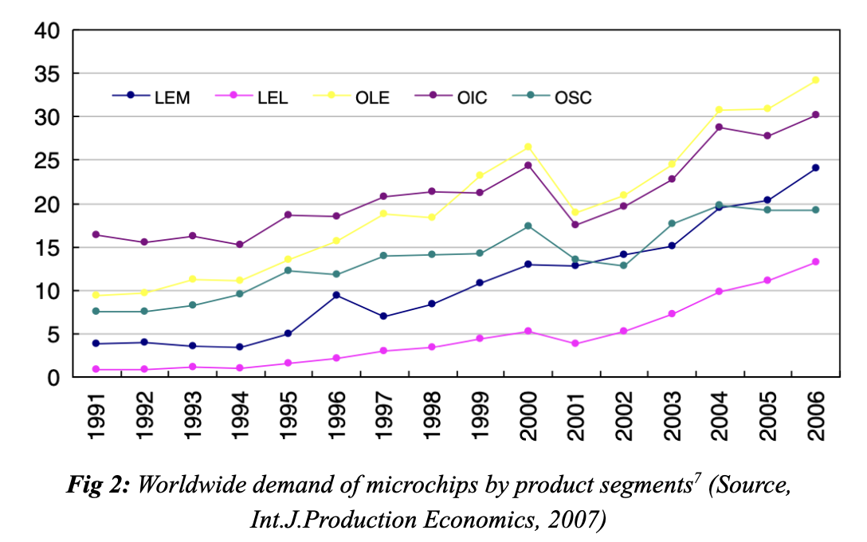
Worldwide Demand for Microchips:
LEM, LEL, OLE, OIC, OSC are different categories of microchips
Overall Increasing Trend
Variance of Increase is uncertain

Slide 5
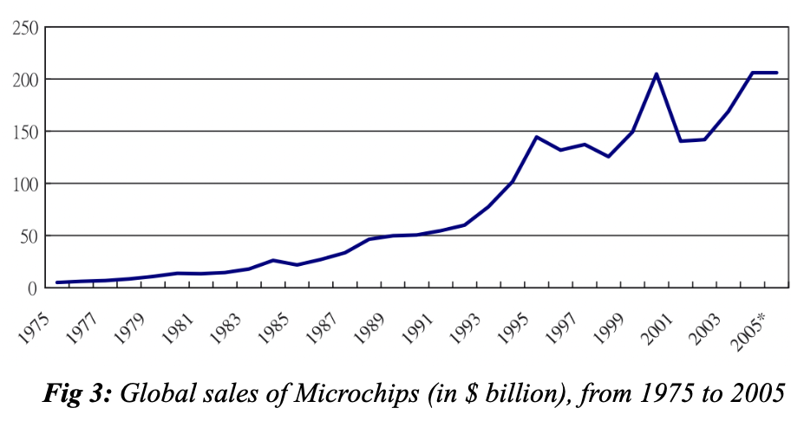
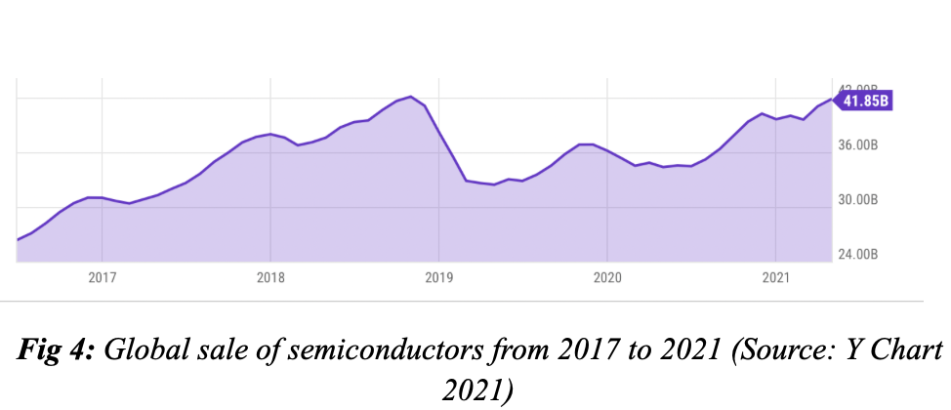
SEMICONDUCTOR MARKET
Uncertain Emergence of Demand
Unpredictable Sales
Volatile Industry

Slide 6



Outsourcing
Rolling – Horizon Flexibility Contract
Constraints of Order Flexibility
Reliability on Inflexible Supply Chain
Unable to Increase Production

Slide 7




In-house Manufacturing
Adopt better scientific & Industrial procedures
Thus, improve manufacturing yield
Able to increase outputs of products if demand increases
Make more revenues

Slide 8





In-house manufacture outsourcing
Bound by Legal Contract
Autonomy in Production
Inflexible in Production
CAPACITY PLANNING
Flexible in Production

Slide 9
REPORT 2
FAB EXPANSION ANALYSIS

Slide 10
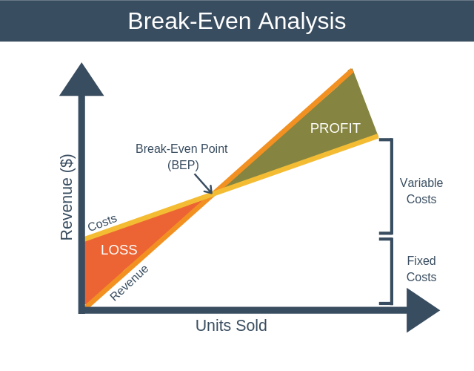
Expectation of returns
Study the point where business’ sale have generated enough revenue to cover all costs and expenses
Using Break-even Analysis to determine if the production output will bring about revenue for company

Slide 11
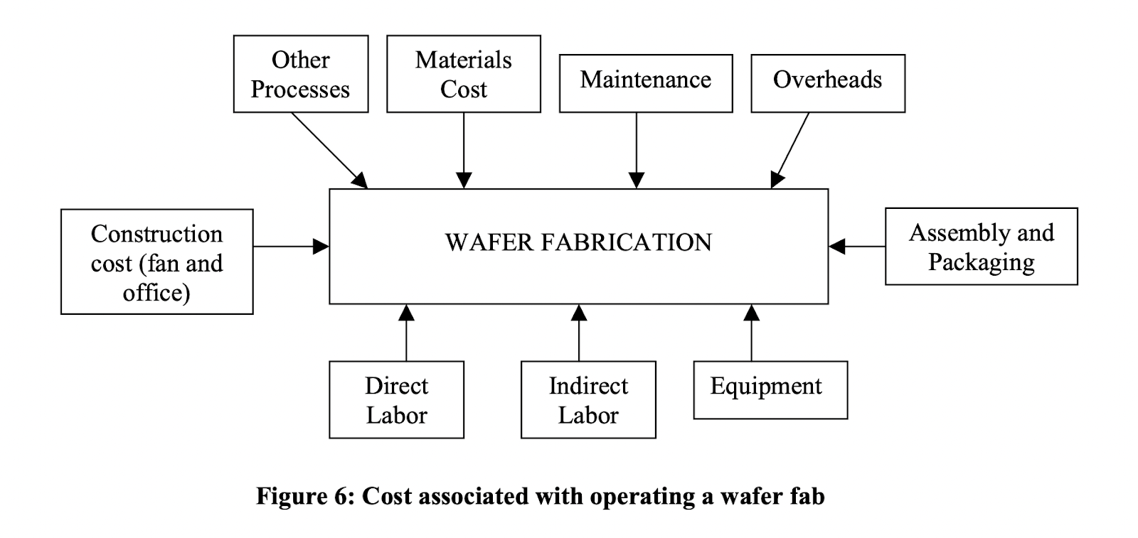
COST OF PROCESSING SEMICONDUCTORS

Slide 12
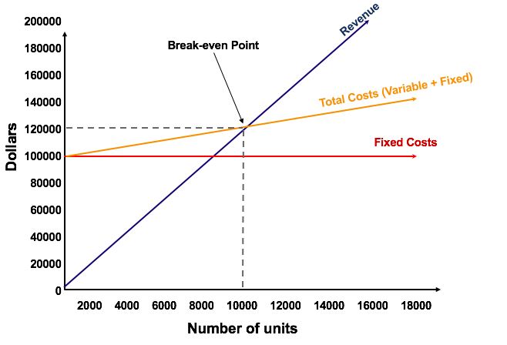
bREAK-EVEN POINT
Revenue = Sales x Price per unit
Total costs = Fixed Costs + Variable Costs
Break-even Point: where revenue from sales are sufficient to cover total costs
Break even Point:
Revenue = Total Costs
Lower BEP is desired

Slide 13
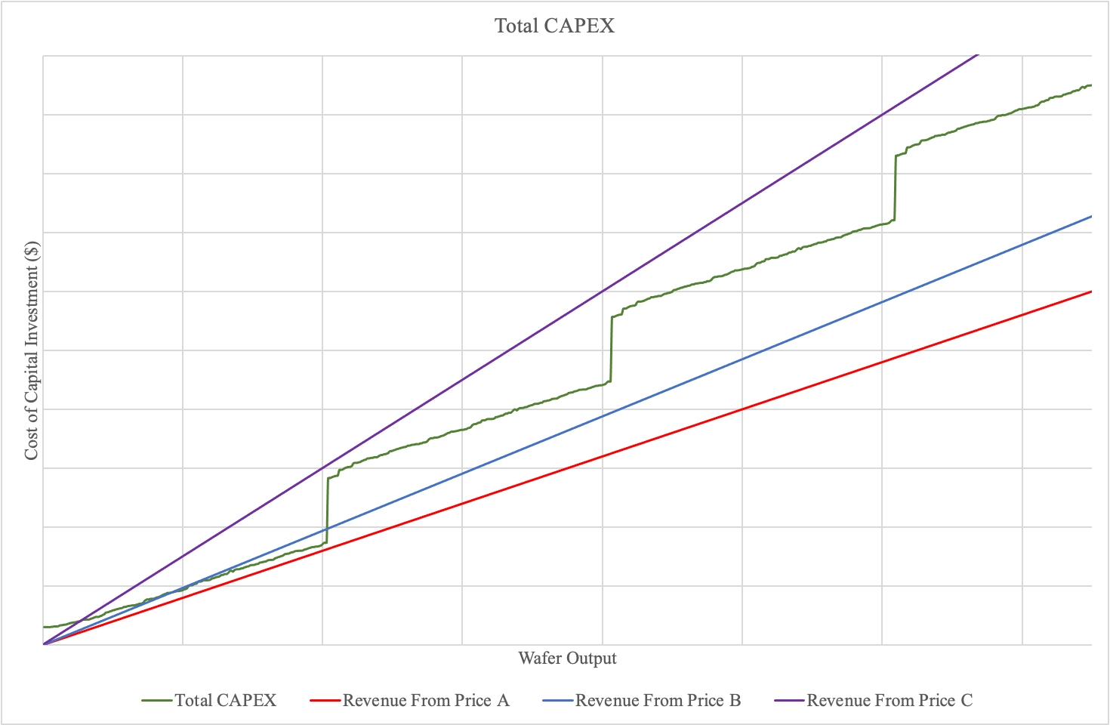
Average selling price, thus, desirable
Before Quantity Qs, revenue is certain
As company increase sales (production output), loss incurred
High selling price, thus, undesirable
Low BEP
Production are certainly lucrative
Low Selling Price, desirable
Costs always higher than Revenue
Production always result in loss

Slide 14
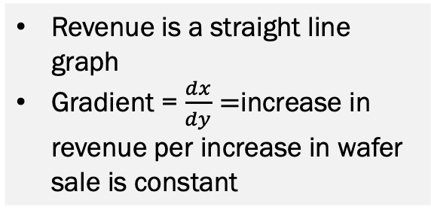
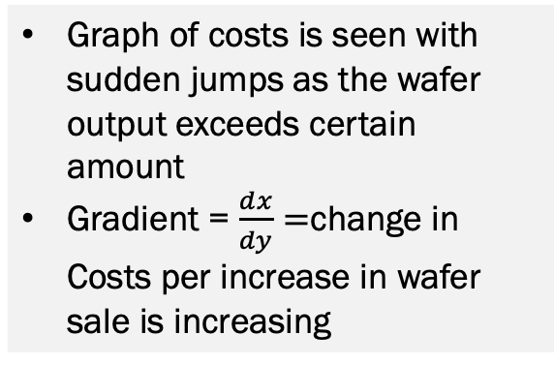
Revenue is a straight line graph
Gradient = $\frac{ⅆx}{dy}=$increase in revenue per increase in wafer sale is constant
Graph of costs is seen with sudden jumps as the wafer output exceeds certain amount
Gradient = $\frac{ⅆx}{dy}=$change in Costs per increase in wafer sale is increasing
Increase in Cost > Increase in Revenue per unit increase in sales
=> Loss > Profit

Slide 15


BREAK-EVEN ANALYSIS
Production Quantity
Costs
Pricing
Provision of manufacturing & production data
Accurate, Predictive Quantiative Analysis
Whether the increase in production from Expansion of Fab is profitable

